Slide 1
WEBSITE BLOCKER

Slide 2
Introduction
In this section of the tutorial, we are going to build a real-time most popular python application known as website blocker.
This application can be used to block the websites so that the user can not open them during the specific period.
Let's discuss how can we build such an application by using python.
A website blocker is a software program that intentionally restricts access to particular sites.
The purpose of website blockers is to deter users from using distracting websites , unwanted website instead of completing their work.
Website blocks can be installed on a particular browser as an extension, or sometimes on a computer hard drive.
A typical blocker allows users to input particular links into a list. All standard browsers have this feature built, which can usually be access through the advanced browser settings menu.
It is also possible to configure an IP address the same way, if desired, blocking a particular site from all computers that share the same network.

Slide 3
ADVANTAGES
Unwanted Sites - One major problem with websites is that a large amount do not feature what you might call G-rated content; i.e. content for all ages. Plus for many people, the content is explicit, hateful, hurtful and very much unwanted.
Examples are porn sites, gambling sites, sites for people to voice their dislike over other races, religions, sexual orientation and more. Not only do you get crude language and x-rated photos on the sites, you can pick up computer bugs or unwanted cookies from the sites, attract nuts and place yourself in danger if you interact with others there. So for all ages, these sites can be dangerous and unwanted.

Slide 4
Fun Sites - Many fun sites like those offering interesting interactions with forums, fun safe games like cards or gaming like the kinds played with Xbox or Nintendo systems, are great - -but time consuming. This may be alright for time off, but for students who should be studying and adults and teens who should be working, they can cause:
- Loss in work production
- Loss in homework time
- Loss in family time
- Low grade
- Low work reviews = lower pay
Additional stress and loss in personal rest-and-relation time also results. So time needs monitored on these types of sites.

Slide 5
Unsafe Sites - Some websites might look like they have a lot to offer, but once you click them on, you can run into technical trouble. For example, you might get scripts that automatically try to take over your computer in different ways, banners and pop-up ads that try and do insert tracking devices into your systems and much more.

Slide 6
DISADVANTAGES
outside interference in the source code of the page, possible interception of data and traffic.
slowing down the website loading speed - the ad blocker needs to process and block advertising elements in the code.
slowdown of the browser speed, freezes may occur in rare cases, and there may also be an increased use of PC resources.
the need for timely update of extensions, otherwise vulnerabilities in the browser security system may appear.
the need to pay in case of using paid extensions.
some sites are ad-supported or their owners earn mostly only from ads, so they may show notifications like “you seem to be using a blocker” and ask you to disable the extension or add their site to the list of exclusions.

Slide 7
the owners of some sites calculate the use of blockers and block the site or part of its content for such visitors, demanding to disable the blocker - in return, they offer disabling ads for money, that is, paid access to their content or viewing with ads.

Slide 8
OBJECTIVES
The objective of Python website blocker is to block some certain websites which can distract the user during the specified amount of time.
In this, we will block the access to the list of some particular websites during the working hours so that the user can only access those websites during the free time only.
The working time in this python application is considered from 9 AM to 5 PM. The time period except that time will be considered as free time.
To block unwanted website
To block corrupted website to safe or secure your system.

Slide 9
PROPOSED OF PROJECT
To block the website we need to use website blocker
To block the unwanted website
To block corrupted website
To block distracting website for sometime.

Slide 10
LITERATURE SURVEY:
Author Name | Year Of Publication | Observation
Ashish Kumar Singh | 2019 | Explains how ads can be blocked in any websites and why should we block some unwanted ads. It also mention how useful it will be if ad is blocked and it will increase user browsing experience. Jing Wang et.al [2] presents paper on Systematic Discovery of Unvalidated Redirects and Forwards in Web Application which helps in understanding how http websites can leak personal information of users and disadvantages of http websites and ads.
Zhou Li et.al | 2019 | Explains how to block unwanted website and corrupted website to safe your system from malware.

Slide 11
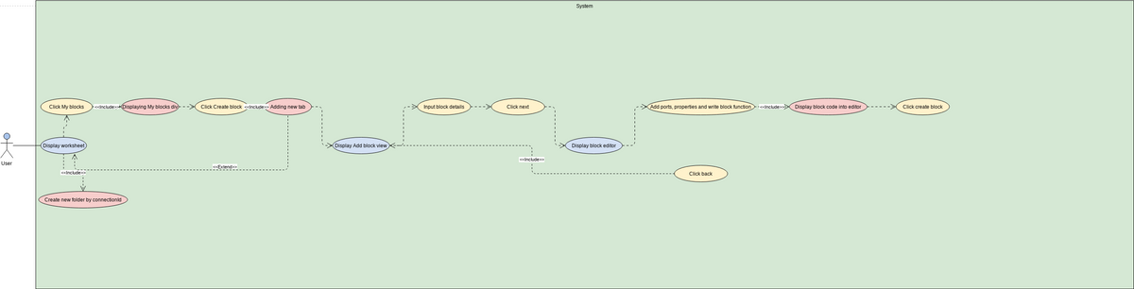
USE CASE DIAGRAM

Slide 12
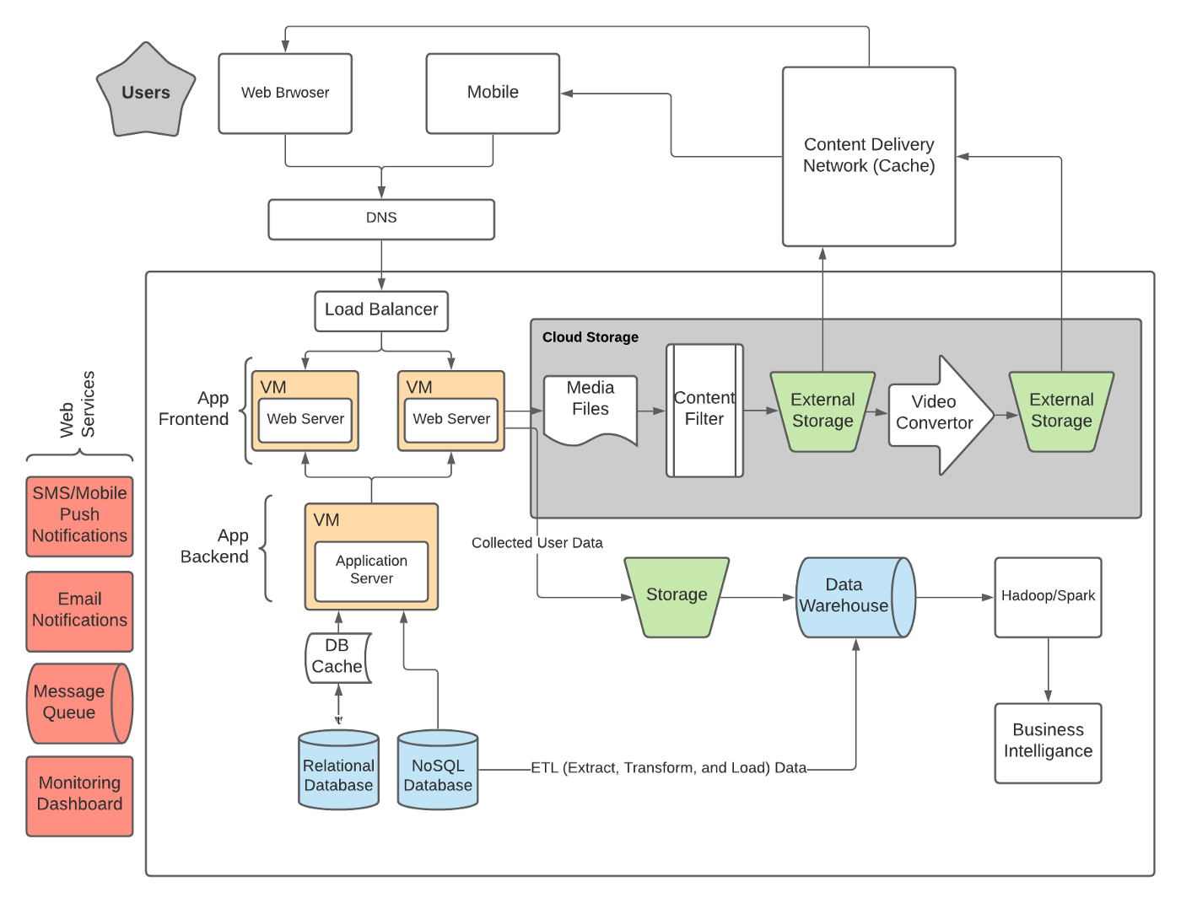
Architecture Diagram:-

Slide 13
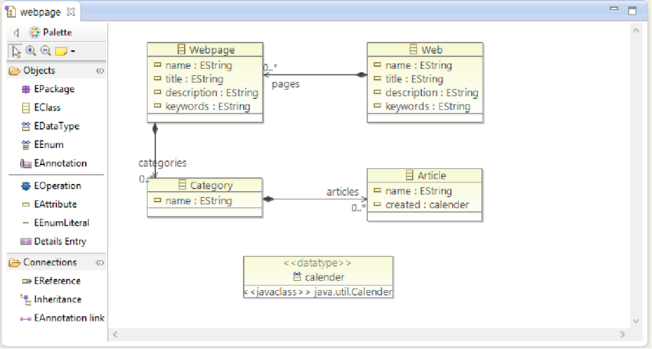
Class Diagram

Slide 14
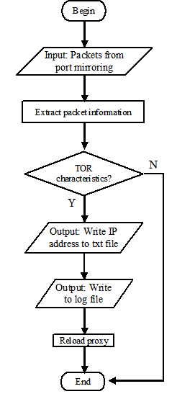
Flow chart

Slide 15
Algorithm :-
Step1:Design the use case diagram under the use case view ,sequence ,class, collaboration,activity,state chart, diagram under the logical view, component diagram under the component view. Deployment diagram under the deployment view for the online ticket reservation system. Step2: Select the menu tool in that chooses the option, in that choose the tab notation and set the default language as ANCI C++ and click ok.
Step3: Goto to the component view ,in that select anyone of the relevant component in the component diagram and right click the component and choose open specification and click the realize tab and assign the classes listed. Step4: Right the same component choose open specification and select general tab andset the language as and press apply.

Slide 16
Step5: Select the same component in the browser window right click it, choose and click generate code. The directory window specifies the directory path where the header file and input files are to be stored and press ok.
Step6: All the required files will be generated in the specified directory. If any change is done in the class diagram does the above steps again.

Slide 17
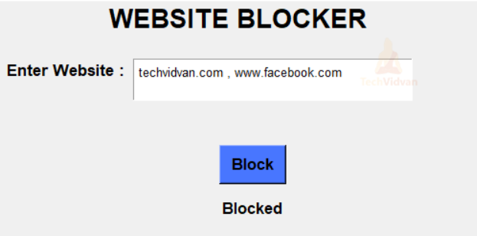
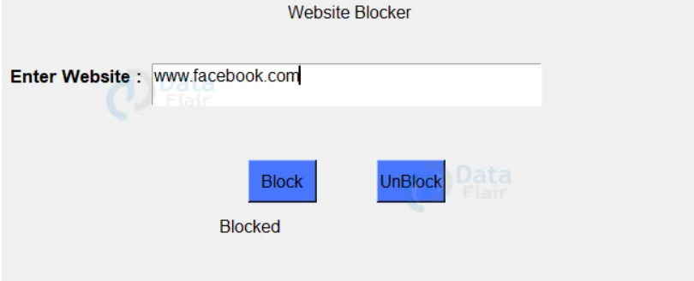
Module:-
1)BLOCK DIVISION: -
To block a particular website
2)UNBLOCK DIVISION:-
To unblock a particular website

Slide 18


